Slide 1





Building a web-based application
that manages activities of the Maid Service
Group 6

Slide 2
Introduction
Supervisor:
Mr. Nguyễn Trọng Tài
Bùi Tiến Tuân
Nguyễn Tấn Công
Mạnh Quang Tuyến
Member

Slide 3
OUTLINE
Scenario Problem
Pros & Cons of Current System
Proposed System
Features
Demo
Achievement, Disadvantages and Future Plan
Questions and Answers

Slide 4


Scenario Problem
Maid service
Customer
Search maid
Hire maid
Maid
Find job
Payment
Apply

Slide 5
Current Systems
timviecnhanh.com
giupviectheogio.vn
Notes:
-Đăng xong rồi phải tự tìm. Chứ không có suggest
-

Slide 6
Current Systems
Not auto suggesting
Maid must have IT knowledge
Notes:
Đưa các hình về việc không có đại diện, không có suggest

Slide 7
Solution
Have maid mediator role
Auto suggest
Notes:
-

Slide 8
Proposed System
Customer
Apply maid
Maid Mediator
Manage maid
Staff
Manage all requests & payment
Suggest
System
Admin
Manage account & config
Notes:
Maid Mediator
Chỉ là người quen, không đóng vai trò môi giới. Chẳng qua chỉ là người biết CNTT để tương tác. Phiếu thu ghi cho maid

Slide 9

Features
Customer
Post recruitment
Apply job request
Maid mediator
Manage maid
Post job request

Slide 10


Features
Staff
Post job request
Manage job request & recruitment
Admin
Manage config
Manage account
Manage maid
Manage payment

Slide 11
Demo
Flow 1
Flow 2

Slide 12



Flow 1: Maid mediator and Staff Demo
Maid mediator
Add maid
Staff
Activate job request
Post job request

Slide 13
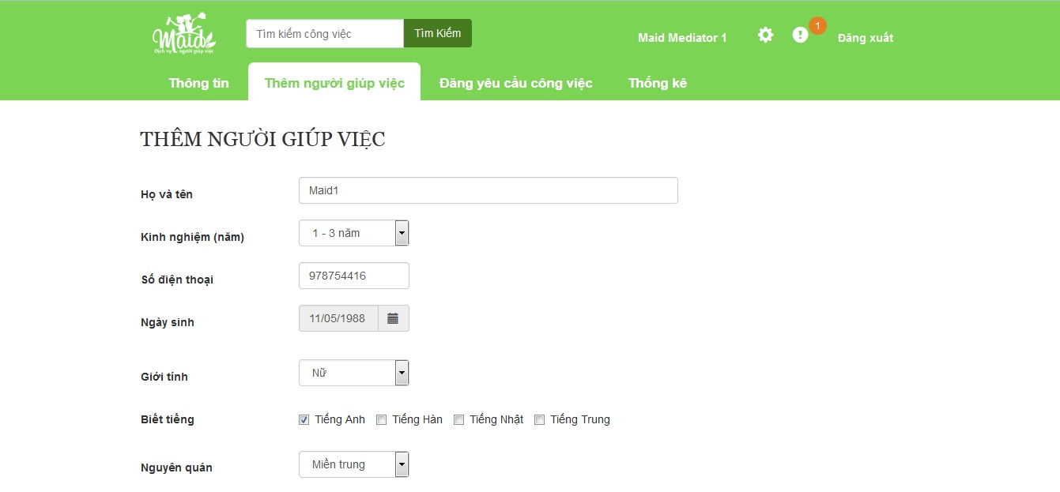
Flow 1: Maid mediator and Staff Demo
Add maid

Slide 14
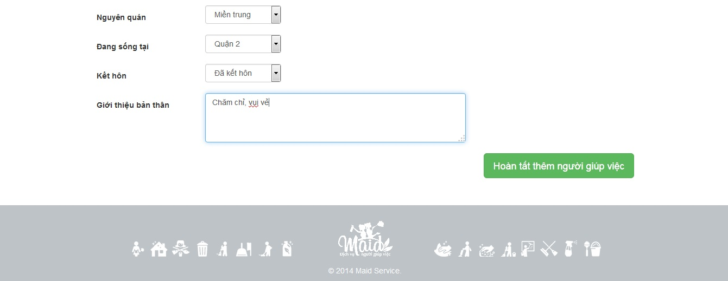
Flow 1: Maid mediator and Staff Demo
Add maid

Slide 15
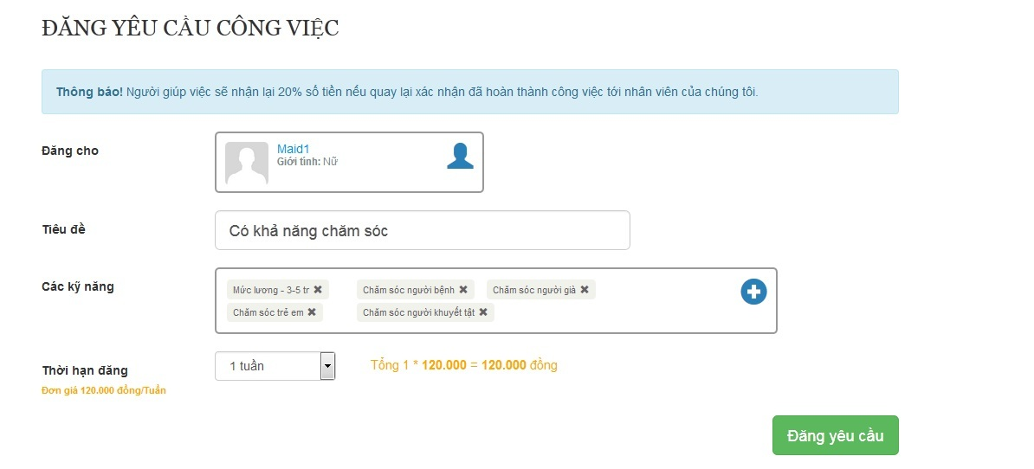
Flow 1: Maid mediator and Staff Demo
Post job request

Slide 16
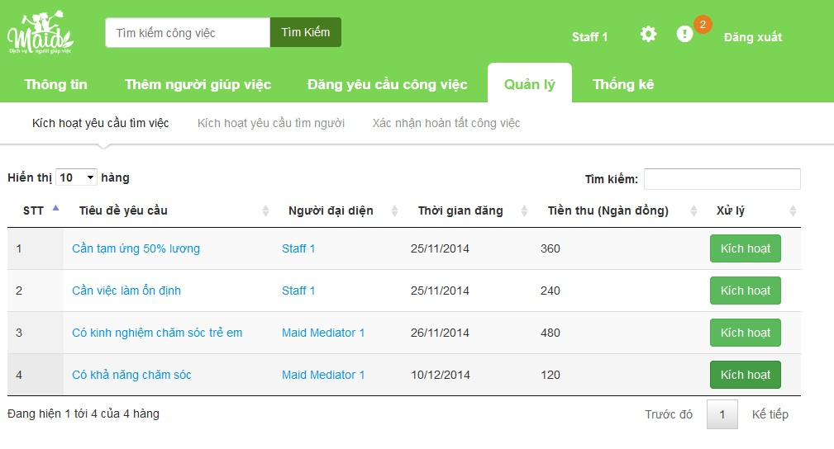
Flow 1: Maid mediator and Staff Demo
Activate job request

Slide 17
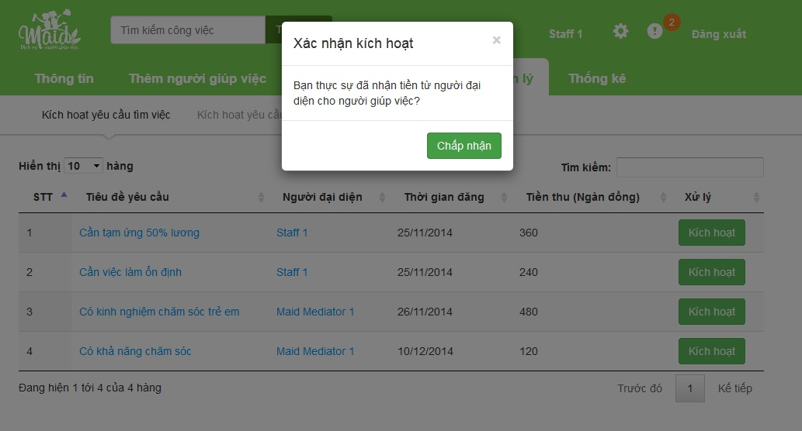
Flow 1: Maid mediator and Staff Demo
Activate job request

Slide 18
Flow2. Customer Scenario Demo
Customer 1 pays on PayPal.
Customer 1 views new posted recruitment.
Customer 2 views a recruitment.
Customer 1 posts a recruitment.
Customer 1 applies a suggested recruitment.
Customer 2 searches a job request.
Customer 2 applies a searched job request.

Slide 19
Recruitment
Nữ
21-30
1-3 năm
Miền trung
Quận 2
3-5 tr
Chăm sóc già
Chăm bệnh
Profile
Nữ
Quận 2
Miền trung
21-30 tuổi
1-3 năm
Suggest
Match
Job Request
Chăm bệnh
Chăm già
Chăm trẻ
Chăm khuyết tật
3-5tr

Slide 20
Recruitment
Profile
Suggest
Not Match
Job Request
Group 6
Maid Service
20

Slide 21




Achievements
Save time for users.
Easy deployment.
Less hand work.

Slide 22
Disadvantages
Only online payment by PayPal service.
Hard to manage human problem.

Slide 23




Future Plan
Online payment with more services.
Build mobile app.

Slide 24
Technology & Tools
Visual Studio 2012
SQL Server 2008 R2
ASP.NET MVC4
JavaScript
JQuery
Bootstrap

Slide 25
Questions and Answers
THANK YOU VERY MUCH!

